Slide 1
Bringing services together to tackle family joblessness.
Toni Wren
Employment and Social Policy Consultant
www.toniwren.com
Australian Social Policy Association and Department of Prime Minister and Cabinet Seminar, Canberra, 22 March, 2012

Slide 2
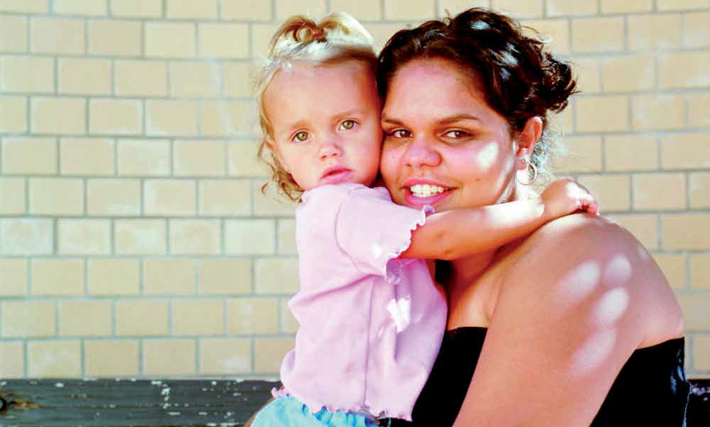
Photo courtesy of The Benevolent Society, Our clients are your clients – bringing services together to tackle family joblessness , Toni Wren, October 2011.
Notes:
Presentation overview
Why tackle family joblessness?
Who are jobless families?
Methodology
Inhibitors to employment
Promising practice
5 strategies for child and family agencies

Slide 3
Why tackle family joblessness?
“A lack of paid employment is the most important cause of child poverty in Australia, and is associated with problems like poor health, higher disability, lower educational attainment and skills, elevated financial stress and increased risk of violence for lone parents.
In Australia around 70 per cent of poor children live in jobless families – the highest share in the OECD – making joblessness the main cause of childhood poverty.”
(Family joblessness in Australia, Peter Whiteford, SPRC Newsletter, Number 102, May 2009.)

Slide 4
Who are jobless families?
632,000 families dependent on income support at November 2011
256,000 or 40% are Jobless Families
(no earnings for > 1 year)
50% have a youngest child aged under 6 and have no requirement to seek work
Indigenous children 3 times as likely as non-Indigenous children to be living in a jobless family
216,000 (84%) are sole parents
Likely to be living in an urban area of locational disadvantage
Likely not to have completed Year 12
Notes:
Jobless family data from DEEWR’s Research Evaluation Database, based on Centrelink administrative data and Growing Up in Australia analysis.
Very few teenage sole parents (~11,000 total) but 25% Indigenous, 90% not completed Year 12.
Nearly 150,000 Parenting Payment Single or Partnered participated in DEEWR Labour Market Assistance in 12 months assistance to June 2011, about 48% in Stream 3. overall Stream 3 helped ~36% of those served into employment during this time.

Slide 5
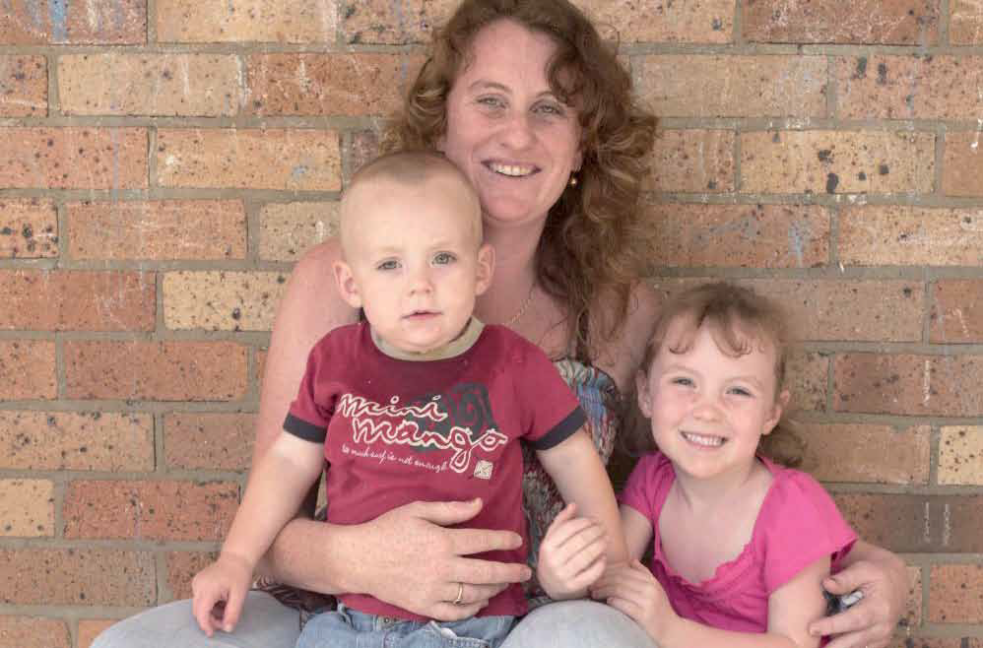
Photo courtesy of The Benevolent Society, Our clients are your clients – bringing services together to tackle family joblessness, Toni Wren, October 2011.
Notes:
Methodology
FCEP in Broadmeadows, VIC and Goodna, QLD.
Innovation Fund jobless family projects in Kwinana, WA & Bundaberg, QLD plus Parent Mentoring Program - Work Savvy Parents.
Strong Young Mums - Centacare NSW.
Also refugee settlement, Integrated Service Provision in mental illness area.
Communities for Children evaluations.
Benevolent Society staff interviews, published data and evaluations.

Slide 6
Inhibitors to employment and crossover between services:
Domestic Violence
Social isolation
Mother’s level of education
Notes:
Prevalent in child and family clients and jobless families.
Goodna FCEP reports 5 domestic violence cases in past 2 weeks and lack of effective DV services, only safe house option available for 1 mother was 2.5 hours away in Warwick.
Brighter Futures and Local Connections to work both show lack of social support as source of vulnerability & joblessness.
Educational attainment is a significant predictor of unemployment. More than half of families (and sole parents) who were jobless in 2004, 2006 and 2008 in the Growing Up in Australia study did not complete Year 12.
The Bundaberg PATH Jobless Family project barriers: low levels of literacy and numeracy, lack of qualifications, as well as long durations out of the workforce.

Slide 7
Inhibitors: systemic
Failure to document, learn, share or replicate what works – particularly in employment.
Silos of funding across government, data protection.
JSA system – competitive, prescribed, high volume caseloads.
Vocational training – patchy quality, poor completion rates, often not linked to employment.
Notes:
7
Jobs Fund - $171M, 225 projects, 9,500 jobs. Only published material are 24 project “success stories”, each of which is 1 page of text. No lessons, purely descriptive.
Nothing published to date on Innovation Fund unless orgs do so themselves.
Kwinana project operating since Dec 2011 at own cost, continuing to support 14 families (17 now working in some form) at March 2012, hoping to get Local Solutions Fund to continue.
JSA Stream 3 outcomes: 35.8% employed; Stream 4 outcomes: 28.5% employed. Around 20% additional in education & training but no employment outcomes available. (DEEWR Labour Market Assistance Outcomes 12 months assistance to June 2011, outcomes at September 2011.)
JSA Stream 4 usually 50 cases per worker.
VET failure documented in Skills Australia reports & Skills for Australia released this week.

Slide 8
Promising Practice - overview
Build self-esteem, reduce social isolation of parents
Engagement
May be via Centrelink requirement or voluntary via other service.
Individual Case Management
20 families per caseworker.
Reduce and address barriers focus on whole family.
Life coaching
to determine best fit career/job in context of role as a Mother.
Vocational training Employment meets needs of local employers and families.
Services work collaboratively

Slide 9
Integration continuum
Case co-ordination without co-location
(Centrelink only)
Co-location of diverse services
(Centrelink Local Connections to Work)
Fully integrated multiple services
(FCEP, mental Illness IPS model, Refugee settlement)
Notes:
Local Connections to Work early outcomes (Based on first 4 locations only – not all parents (unknown breakdown)
Higher attendance rate (66% versus 58% normal JSA interview attendance rate). Letter from Centrelink, not provider, main reason.
50% higher job placement rate than for similar clients who had not participated.
First 8 months: >200 job placements
Client feedback: 82% better than previous Centrelink interviews and service and 73% better than JSA interview and service.
Provider feedback: Centrelink and employment service providers working well together; community partners building stronger links with each other, Centrelink office is convenient access point for service delivery to clients.
Source: Taskforce on Strengthening Government for Job Seekers, Report delivered 30 March 2011, published July 2011.

Slide 10
5 Strategies for child and family services
Reduce barriers to pathways by addressing domestic violence, social isolation.
Engage families via child and family services, especially those with children less than six and no compulsion to participate.
Collaborate with integrated and co-located services; dedicated jobless family programs if available.
Focus on Mother's education levels - improve skills by building self-esteem, lifecoach/mentoring; learning through doing in the context of their role as carers and offer work tasters, work experience, and student vocational placements.
Directly employ jobless families (within services and social enterprises) and drive more effective employment and training programs for them.
Notes:
Parenting Mentoring Program (Work Savvy Parents) - ran for 18 months to February 2011 under the Innovation Fund program. 168 participants commenced. All participants were jobless families living in disadvantaged communities in NSW and Queensland. Of these 47% obtained employment and 20% entered vocational education, a total of 67%. Used mentoring and life coaching model which supported the participants gain education and employment outcomes, through the lens of them as mothers.
Strong Young Mums (Centacare)– started Bourke mid 2005, focus on young Indigenous Mothers. The program focuses on re-engagement with education, as well as teaching parenting skills and providing information about services. It also supports young mothers experiencing violence in their relationships to take action. Outcomes from 2006 to 2011: 120 participants with 60% engaging in informal and accredited training, ranging from art and photography workshops to certificate level II and III courses in childcare, aged care, hospitality, and fashion. Some women have also completed their School Certificate and their HSC through the program. One quarter of the women have also found employment. This is a strong outcome in an area of high unemployment.

Slide 11
Key messages
Our clients are your clients – learn, collaborate,replicate.
Focus on domestic violence, social isolation, Mother’s level of education.
Integrate services/intensive case management.
Reform JSA/VET to better meet needs of families and employers.
Notes:
11

Slide 12
See
www.bensoc.org.au
“Resources”
or
www.toniwren.com for a copy
of the full paper.

